Slide 1
Design and Simulation of a Digital Patient Emergency Alarm and Alert System Using Combination Logic
PRESENTED BY
Karthikeya – 2620090056
Harsha – 2620090042
Dhanush – 2620090049
Rohan – 2620090048
Sathvik - 2620090047

Slide 2

PATIENT MONITORING
Patient monitoring is very important in hospitals, especially in critical care environments.
Different parameters such as heart rate, body temperature, oxygen level, and blood pressure need to be monitored.
In our project, these conditions are represented using digital signals.
A value of 0 represents a normal condition, while 1 represents an abnormal condition.
The system processes these inputs using combinational logic and generates an alarm whenever an abnormal condition is detected.

Slide 3
OBJECTIVES
The main objectives of our project are:
First, to design a digital patient alarm system using combinational logic.
Second, to understand the practical application of logic gates and Boolean algebra.
Third, to detect abnormal conditions using digital inputs.
And finally, to simulate and verify the circuit using digital simulation software.

Slide 4
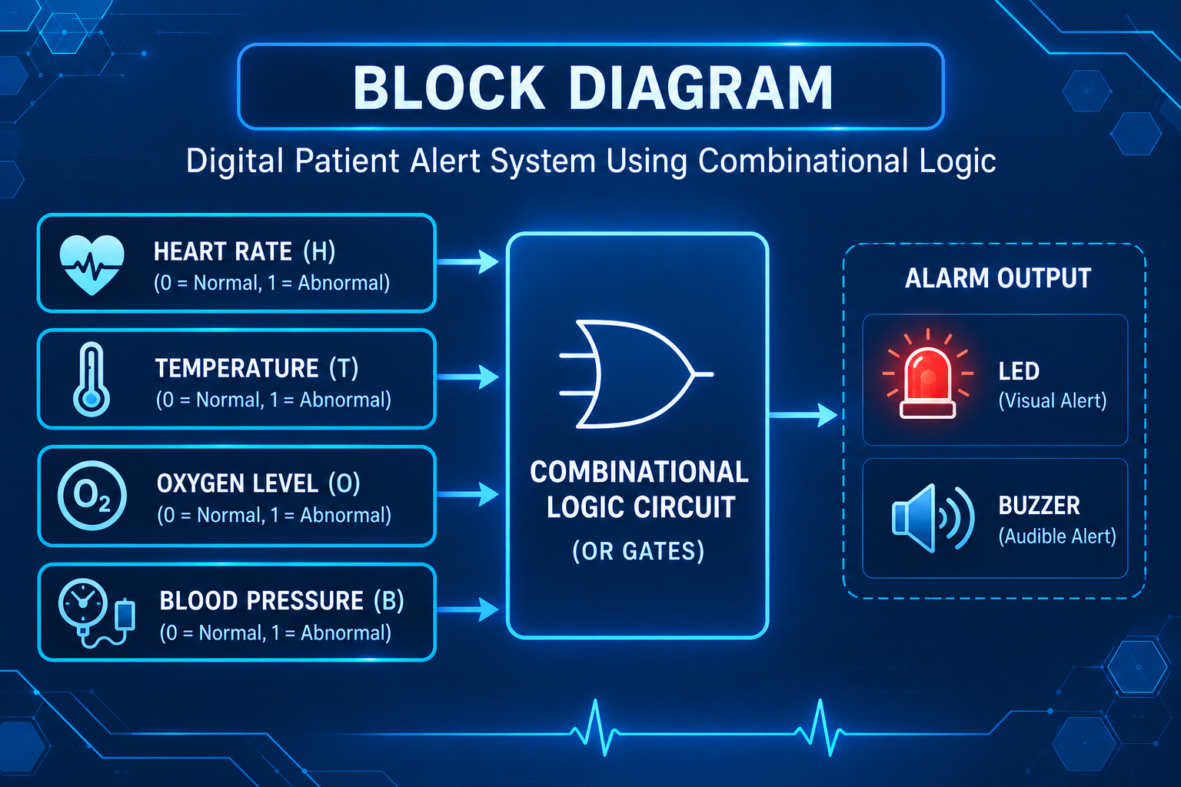
BLOCK DIAGRAM
This is the block diagram of our proposed system.
We have four inputs: heart rate, temperature, oxygen level, and blood pressure.
These inputs are given to the combinational logic circuit.
The logic circuit processes the inputs and produces one output called the alarm output.
If any one of the inputs becomes abnormal, the alarm is activated using an LED or buzzer.

Slide 5
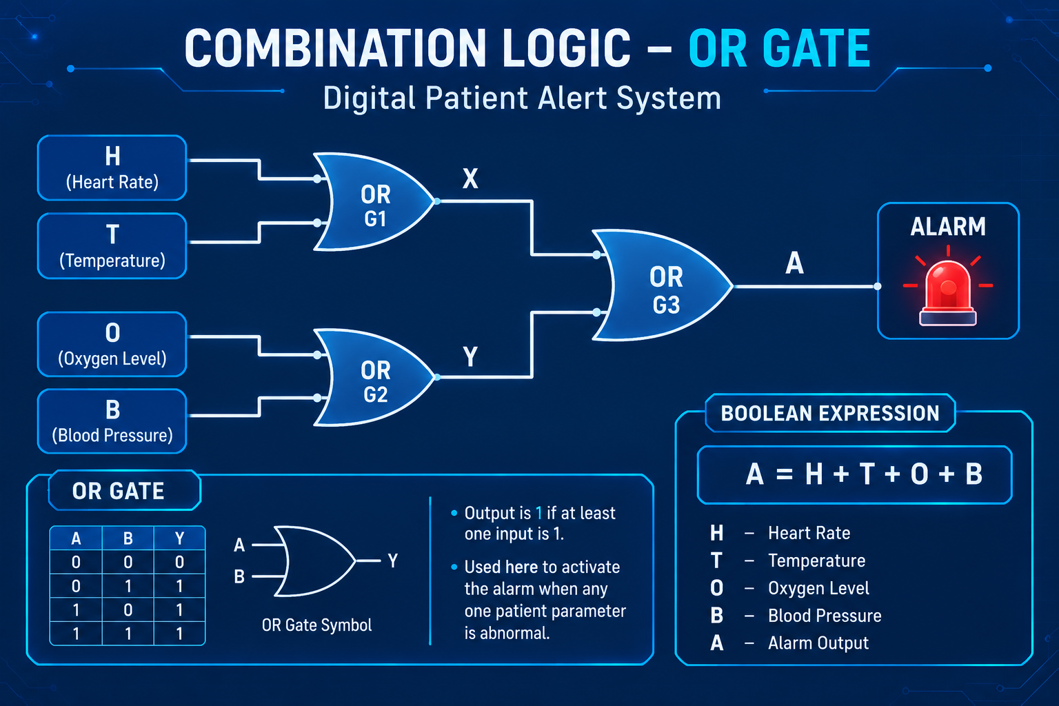
COMBINATIONAL LOGIC
The main logic used in our project is the OR gate.
An OR gate produces an output of 1 when at least one of its inputs is 1.
This makes the OR gate suitable for our project because we want the alarm to activate when any patient parameter becomes abnormal.
So our basic logic function is:
A equals H OR T OR O OR B.

Slide 6
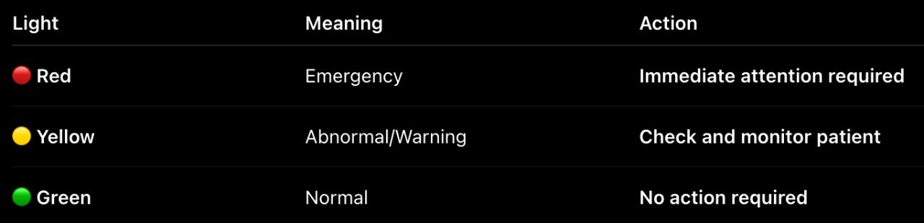
CIRCUIT DIAGRAM
This is our circuit diagram.
Since we are using four inputs, we can use two 2-input OR gates.
The first OR gate combines heart rate and temperature.
The second OR gate combines oxygen level and blood pressure.
The outputs of one OR gates is then connected to the NOT gate.
Finally, the output is connected to an LED or buzzer.
When the output is 1, the alarm turns ON.

Slide 7
BOOLEAN EXPRESSION
The Boolean expression for our circuit is:
A = H + T + O + B
Here, the plus symbol represents the OR operation.
H represents abnormal heart rate, T represents abnormal temperature, O represents abnormal oxygen level, and B represents abnormal blood pressure.
Therefore, if any of these inputs is 1, the alarm output becomes 1.

Slide 8
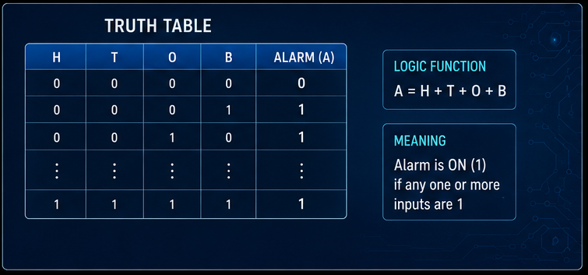
TRUTH TABLE
This is the truth table for our system.
Since we have four inputs, the total number of possible combinations is:
2 to the power 4, which is 16 combinations.
When all four inputs are zero, the alarm output is zero.
For every other combination, at least one input is one, so the alarm output becomes one.
Therefore, the alarm is activated whenever any abnormal condition is detected.

Slide 9
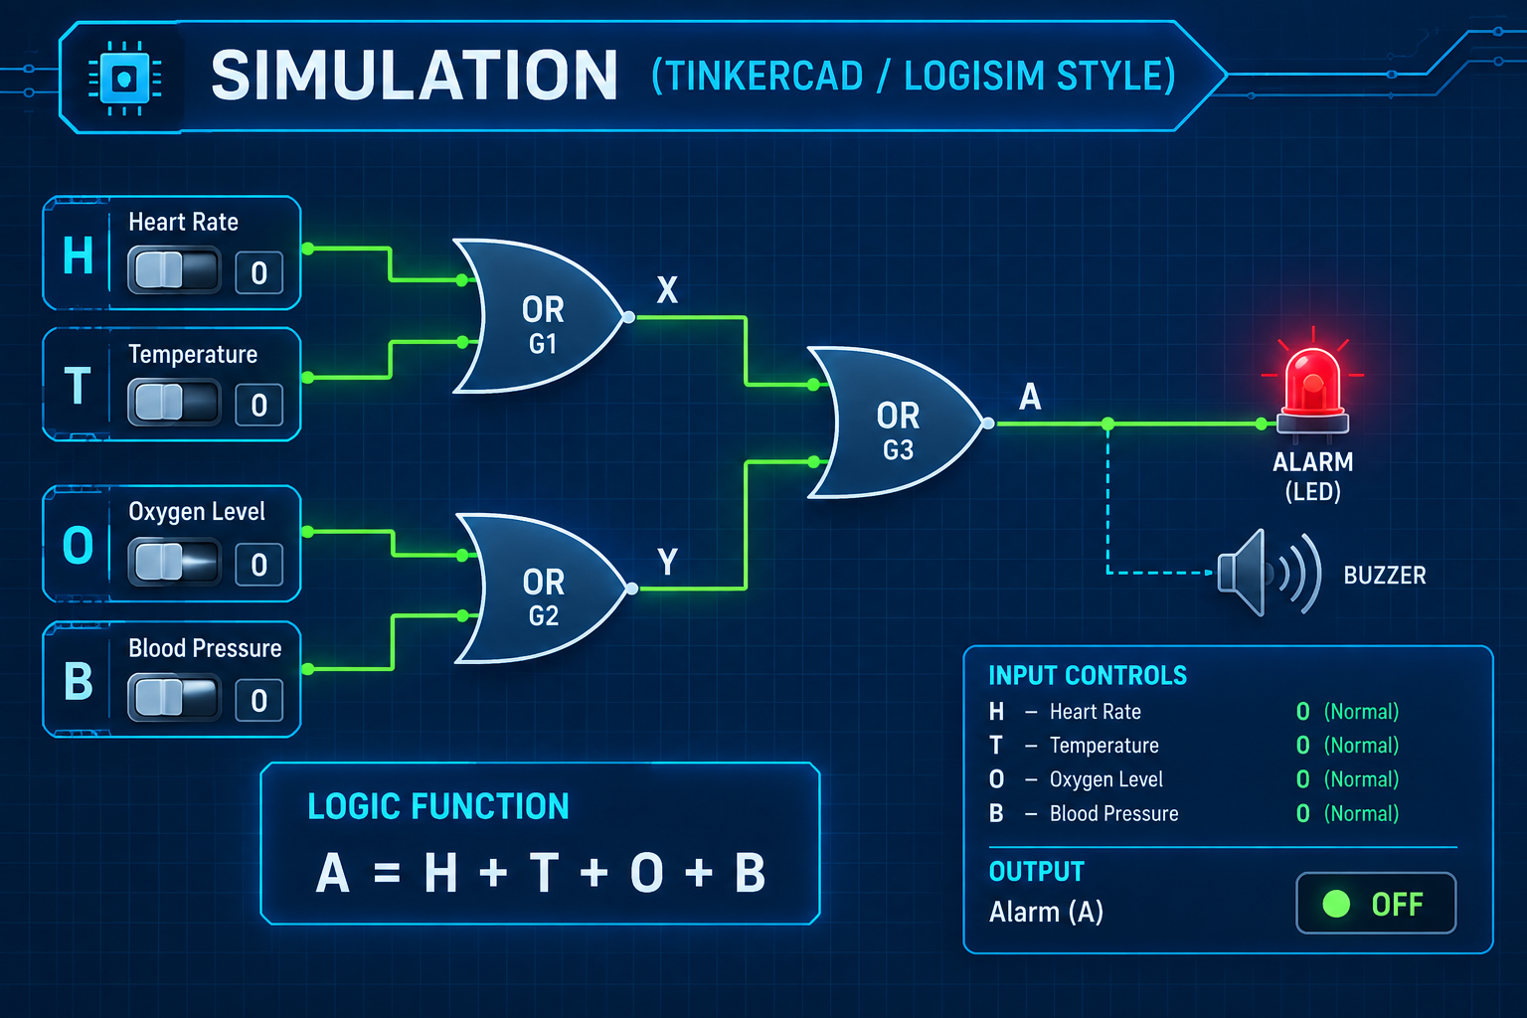
SIMULATION
Now we can see the simulation of our circuit.
We have used switches to represent the four patient conditions.
The switches are connected to OR gates, and the final output is connected to an LED.
When all switches are OFF, the LED is OFF.
If we turn ON any one switch, the LED immediately turns ON.
This confirms that our circuit is working according to the Boolean expression and truth table.

Slide 10
ADVANTAGES
There are several advantages of this system.
First, the circuit is simple and easy to understand.
Second, it provides a fast response because it uses combinational logic.
Third, it requires only basic digital components.
It is also easy to simulate, inexpensive, and can be expanded by adding more inputs.

Slide 11
APPLICATIONS & FUTURE SCOPE
This concept can be applied to patient monitoring systems, hospital alarm systems, ICU monitoring concepts, and emergency alert systems.
In the future, the project can be improved by connecting real sensors for temperature, heart rate, oxygen level, and blood pressure.
We can also add a microcontroller, LCD display, wireless communication, and individual warning indicators.
This would make the system more advanced and practical.

Slide 12
CONCLUSION
To conclude, we successfully designed and simulated a digital patient alarm system using combinational logic.
The system uses four digital inputs representing different patient conditions.
Using OR gates, the system activates an alarm whenever at least one abnormal condition is detected.
This project helped us understand the practical application of logic gates, Boolean expressions, truth tables, and digital circuit simulation.
Thank you for listening to our presentation.
I am ready to answer any questions.

Slide 13

Thank you for listening to our presentation.

